Slide 1
Pitch Deck Template
Make a copy of this deck.
Do NOT add or remove any slides
Don’t forget to click on ‘Share’ and set ‘General Access’ to anyone with the link can view

Slide 2

SANKALP:
Digital Truth At Source
By: Copy Paste

Slide 3
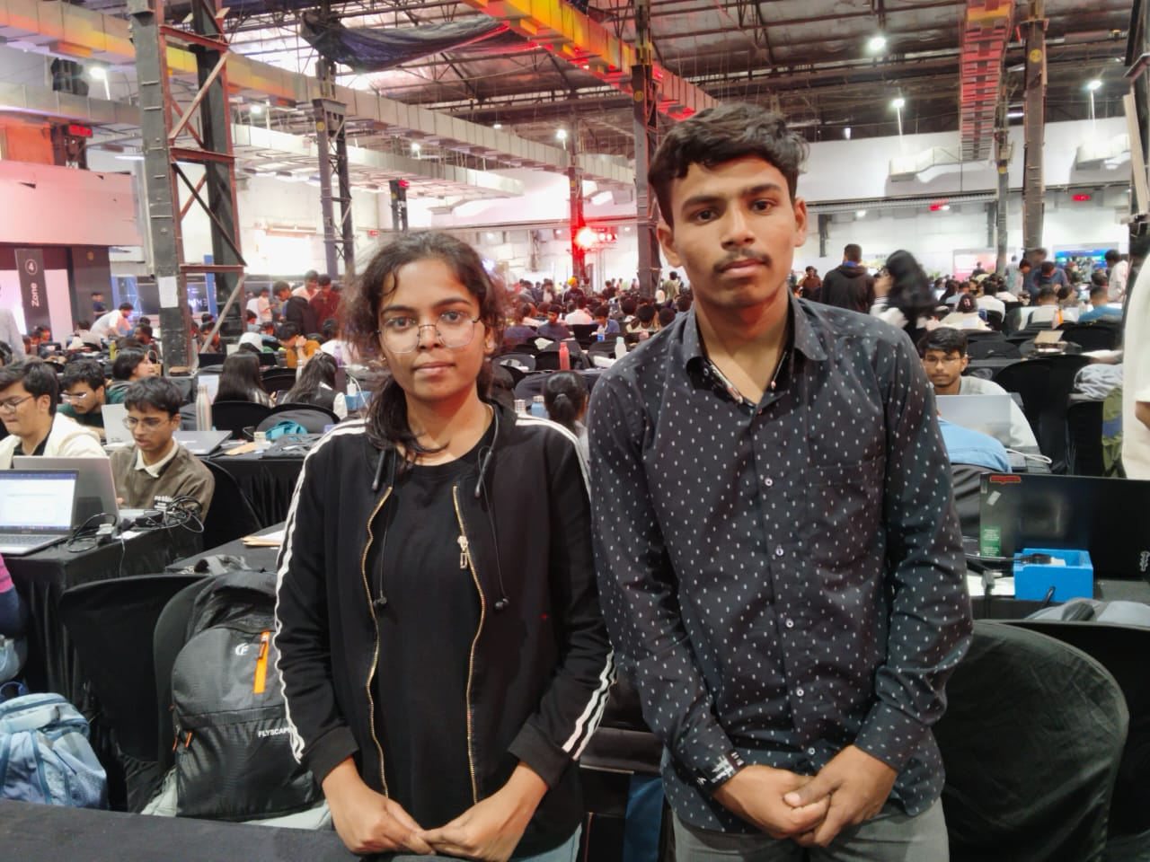
A picture of your team!
Tanuja Ashruba Ingle (9421570522) | Abhishek Ashruba Ingle (9970398056)

Slide 4
Problem Statement
Deepfakes, AI-generated misinformation, and edited media are eroding public trust in journalism, governance, and social media.Existing tools reactively detect fakes — often too late to prevent the damage.Sankalp solves this by building a proactive, verifiable trust layer for digital media, combining AI reasoning with blockchain-based proof.

Slide 5
Solution
Sankalp – The Solution We Are DeliveringSankalp provides a complete decentralized, AI-powered trust layer for digital media by ensuring every photo, video, and statement is:
*Verified at the moment of creation
*Cryptographically sealed using blockchain
*Privately validated using Zero-Knowledge Proofs *Continuously monitored for tampering across the internet

Slide 6
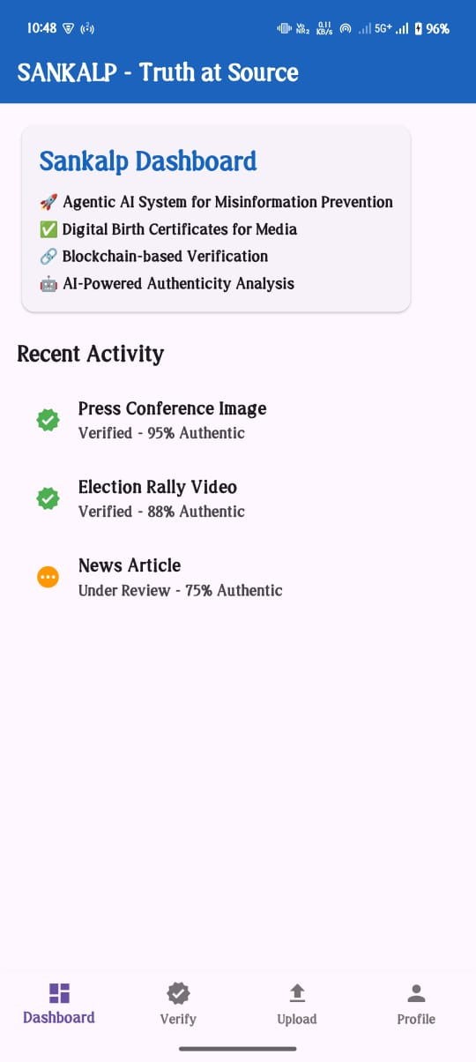
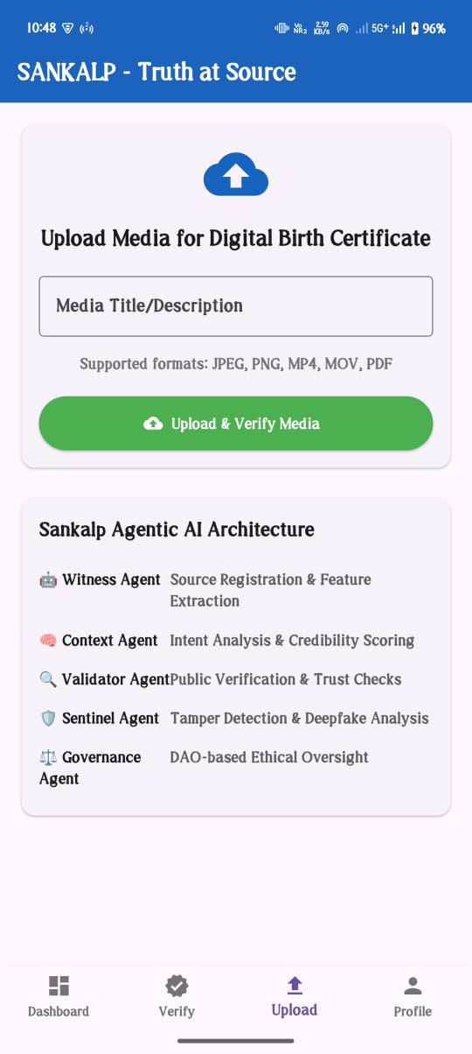
Screenshot 1

Slide 7
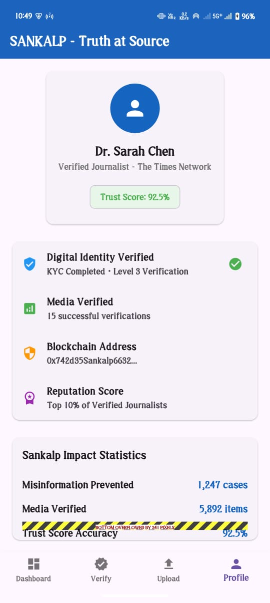
Screenshot 2

Slide 8
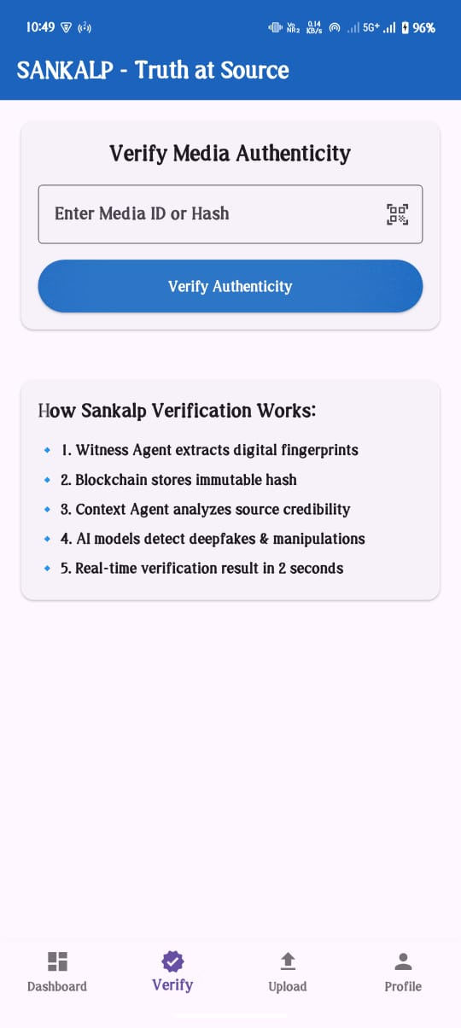
Screenshot 3

Slide 9
Business Model
SaaS for News Agencies
API Subscription for Social Media Apps
Government/Police Contracts
Chrome Extension Freemium Model
Corporate Security & Compliance Packages
Sentinel Monitoring as a Paid Service

Slide 10
Anything else?
This Prototype of Agentic AI model is made for images only cause of time constraints our future goal is to create this for video ,recordings etc. which contains sensitive information which will lead to privacy and truth of information this our SANKALP

Slide 11
Thank you
For Giving us opportunity to build Agentic AI model at this much big event.

